Slide 1
CS405/505 Data Mining
Lecture 22

Slide 2
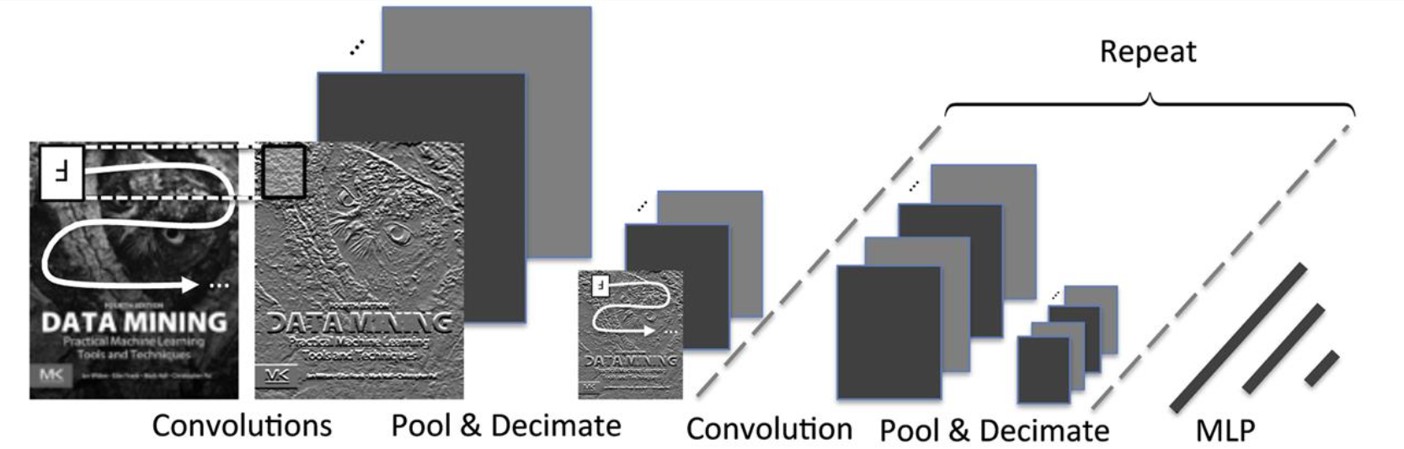
Convolutional neural networks (CNNs)
Convolutional neural networks are a special type of feedforward network that has proven very successful for image analysis
CNNs learn convolutional filters and classifiers simultaneously using gradient descent and backpropagation
In a CNN, once an image has been filtered by several learnable filters, each filter bank’s output if often aggregated across a small spatial region using max or mean
Typical CNN network structure: small parts of input image are subjected to repeated phases of convolutional filtering, pooling, and decimation before being passed to a fully connected, nonconvolutional multilayer perceptron which makes a final prediction

Slide 3
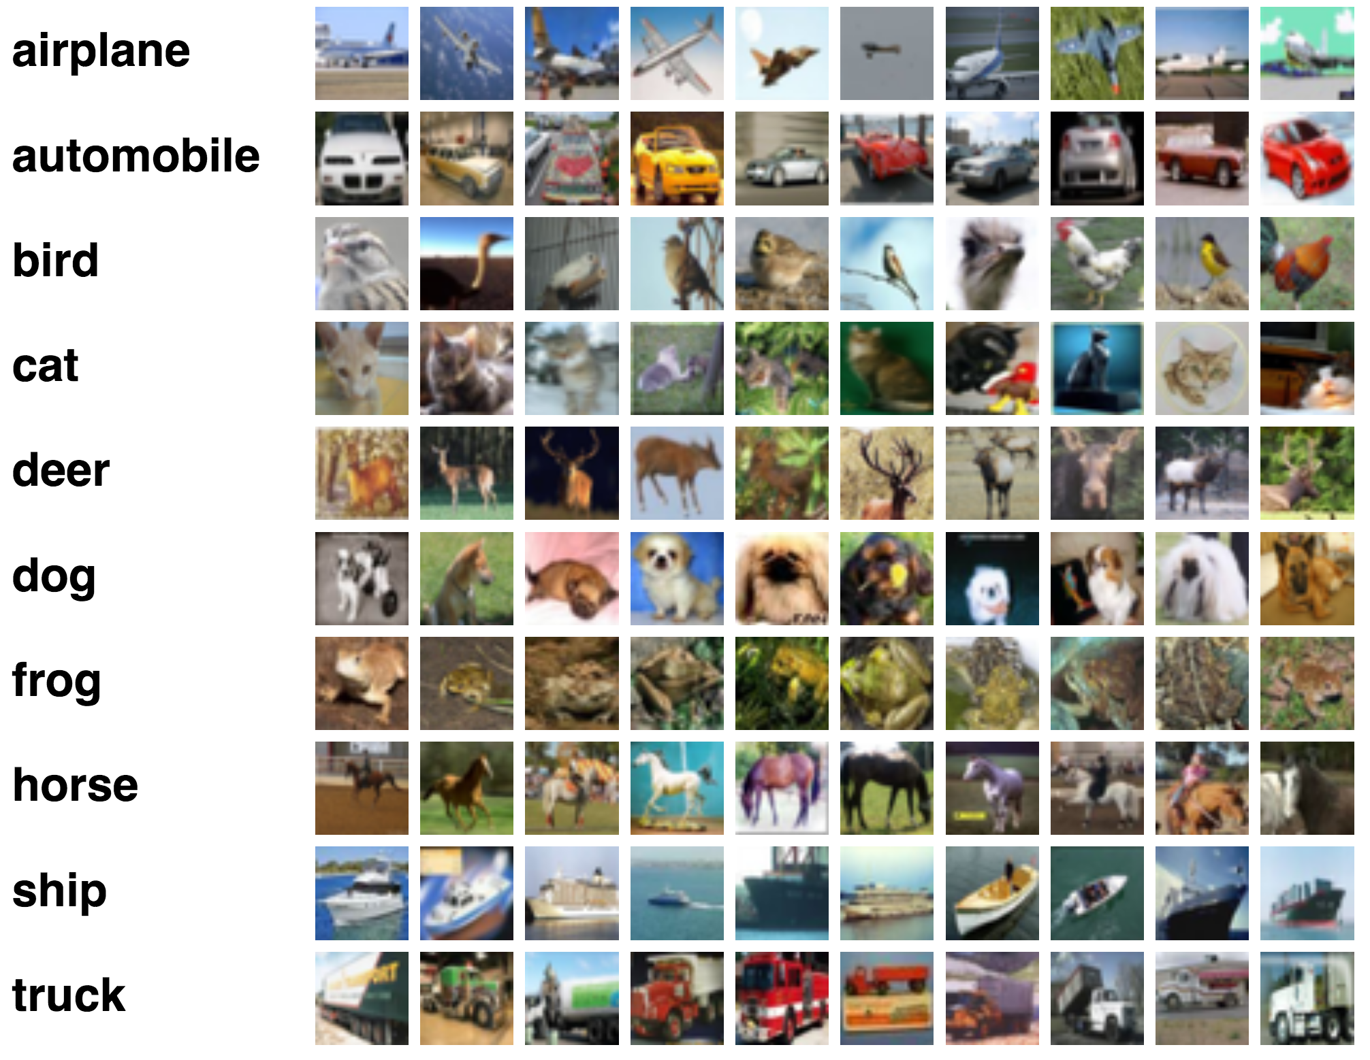
ImageNet
ImageNet challenge crucial in demonstrating effectiveness of deep CNNs
1.2 million images in training set, 1000 classes, 732-1000 images per class
Random subset of 100,000 images for test set, 50,000 images for validation set
Images hand-labeled based on presence/absence of object categories

Slide 4
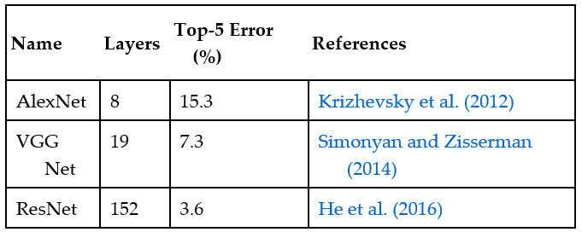
ImageNet
Visual recognition methods not based on CNNs hit 25% plateau on ImageNet
Many non-CNN methods can not get above 25% in the “top-5 error”
Top-5 error = percentage of times target label does not appear among 5 highest-probability predictions
CNNs dramatically outperform the 25% plateau
Increasing network depth can further improve performance
Small filters (3x3) lead to superior results in deep networks
Performance for human agreement is 5.1%, so deep CNNs outperform people
Learn more about “human accuracy” here: http://karpathy.github.io/2014/09/02/what-i-learned-from-competing-against-a-convnet-on-imagenet/

Slide 5
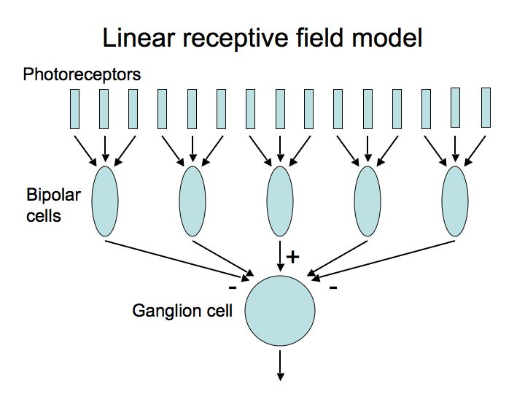
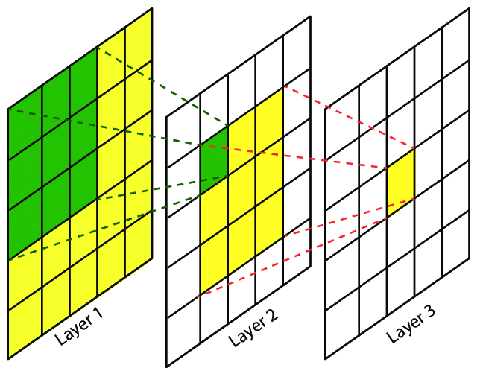
From image filtering to learnable convolutional layers
Filtering an image yields another image whose pixel values contain the filter’s response at each spatial location
Could think of a filtered image as a feature map (ie, where edges exist in image)
In deep networks, feature maps are subjected to many further levels of filtering
Over many successive filter applications produces spatially organized neurons that respond to much more complex inputs
When viewed as layers in a neural network that takes images as input, filtering operations constrain spatially organized neurons to respond only to features within a limited region of input known as neuron’s receptive field
The receptive field of each convolutional layer with a 3x3 kernel, green area marks receptive field of one neuron in layer 2, yellow marks receptive field of one neuron in layer 3
https://www.researchgate.net/publication/316950618_Maritime_Semantic_Labeling_of_Optical_Remote_Sensing_Images_with_Multi-Scale_Fully_Convolutional_Network

Slide 6
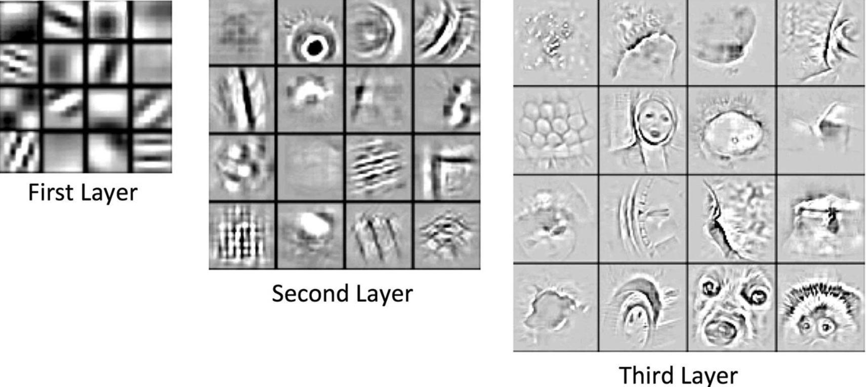
Learned filters
Edge-like and texture-like filters are frequently observed in early layers of CNN trained using natural images
Each layer in CNN involves filtering the feature map produced by the layer below
This means deeper layers have larger receptive fields
Deeper layers detect larger features, which can correspond to small pieces of objects in mid-level layers, and entire objects at deepest layers
Examples of the strongest activation from some neurons in each layer, projecting the activation back into image space using deconvolution

Slide 7
Spatial pooling
Spatial pooling operations are used to give local translational invariance to precise location where features have been detected
If pooling is done by averaging, can be implemented using convolutions
CNNs apply multiple layers of convolution, followed by pooling/decimation layers
Common to have 3 phases of pooling/decimation
After the last pooling/decimation layer, resulting feature maps fed into MLP
Decimation reduces size of feature maps, so each pooling/decimation step reduces size of subsequent activity map
Extremely deep convolutional networks (>8 layers) typically repeat convolutional layers many times before applying the pooling/decimation operations

Slide 8
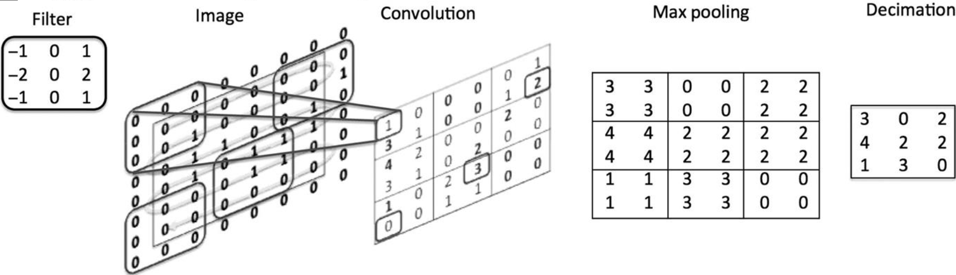
Convolution, pooling, decimation
Numerical example of key operations of convolution, pooling, and decimation
Image is first convolved with Filter
Curved rectangular regions in Image represent random set of image locations
Next matrix shows result of convolutional operation, maximum values in bold
Result is then pooled using max-pooling
Pooled matrix is decimated by factor of 2 to yield final result

Slide 9
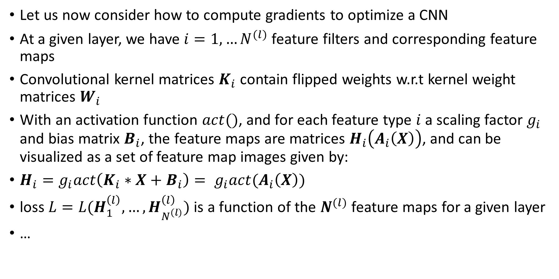
Convolutional layers and gradients
Let us now consider how to compute gradients to optimize a CNN
At a given layer, we have $i=1,…N^{(l)}$ feature filters and corresponding feature maps
Convolutional kernel matrices $K_{i}$ contain flipped weights w.r.t kernel weight matrices $W_{i}$
With an activation function $act()$, and for each feature type $i$ a scaling factor $g_{i}$ and bias matrix $B_{i}$, the feature maps are matrices $H_{i}\left(A_{i}\left(X\right)\right)$, and can be visualized as a set of feature map images given by:
$H_{i}=g_{i}act\left(K_{i}∗X+B_{i}\right)= g_{i}act(A_{i}\left(X\right))$
loss $L=L(H_{1}^{\left(l\right)},…,H_{N^{\left(l\right)}}^{\left(l\right)})$ is a function of the $N^{(l)}$ feature maps for a given layer
…

Slide 10
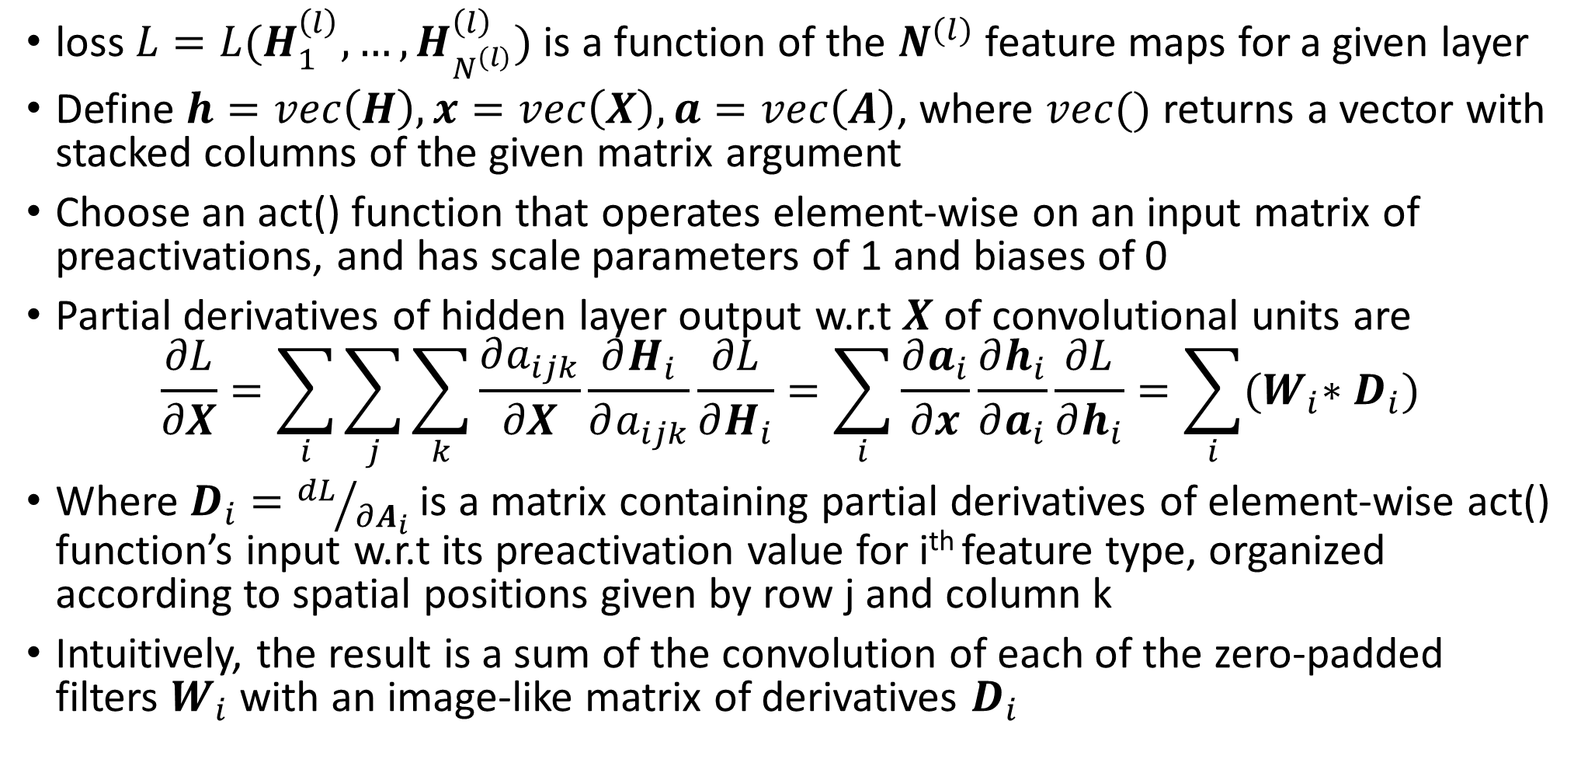
Convolutional layers and gradients
loss $L=L(H_{1}^{\left(l\right)},…,H_{N^{\left(l\right)}}^{\left(l\right)})$ is a function of the $N^{(l)}$ feature maps for a given layer
Define $h=vec\left(H\right), x=vec\left(X\right), a=vec\left(A\right)$, where $vec()$ returns a vector with stacked columns of the given matrix argument
Choose an act() function that operates element-wise on an input matrix of preactivations, and has scale parameters of 1 and biases of 0
Partial derivatives of hidden layer output w.r.t $X$ of convolutional units are
$$\frac{∂L}{∂X}=\sum_{i}{\sum_{j}{\sum_{k}{\frac{∂a_{ijk}}{∂X}\frac{∂H_{i}}{∂a_{ijk}}\frac{∂L}{∂H_{i}}=\sum_{i}{\frac{∂a_{i}}{∂x}\frac{∂h_{i}}{∂a_{i}}\frac{∂L}{∂h_{i}}=\sum_{i}{{(W}_{i}∗D_{i}}}}}})$$
Where $D_{i}={dL}/{∂A_{i}}$ is a matrix containing partial derivatives of element-wise act() function’s input w.r.t its preactivation value for i^{th} feature type, organized according to spatial positions given by row j and column k
Intuitively, the result is a sum of the convolution of each of the zero-padded filters $W_{i}$ with an image-like matrix of derivatives $D_{i}$

Slide 11
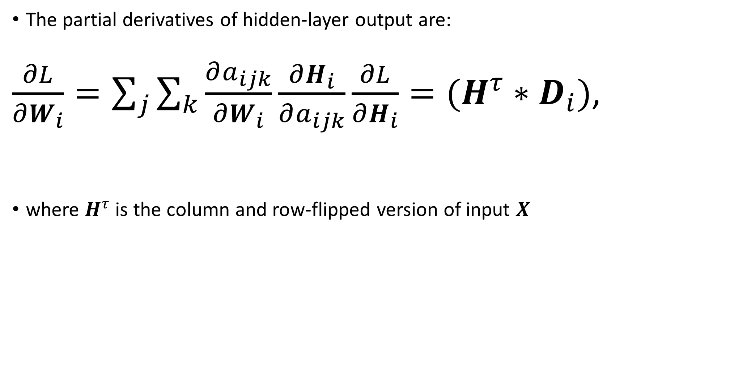
Convolutional layers and gradients
The partial derivatives of hidden-layer output are:
$\frac{∂L}{∂W_{i}}=\sum_{j}{\sum_{k}{\frac{∂a_{ijk}}{∂W_{i}}\frac{∂H_{i}}{∂a_{ijk}}}}\frac{∂L}{∂H_{i}}=(H^{τ}∗D_{i})$,
where $H^{τ}$ is the column and row-flipped version of input $X$

Slide 12
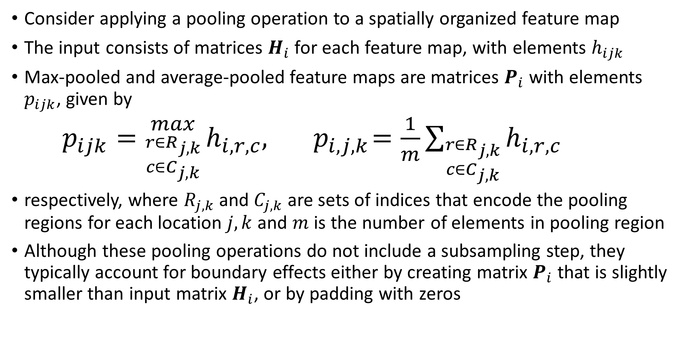
Pooling and subsampling layers and gradients
Consider applying a pooling operation to a spatially organized feature map
The input consists of matrices $H_{i}$ for each feature map, with elements $h_{ijk}$
Max-pooled and average-pooled feature maps are matrices $P_{i}$ with elements $p_{ijk}$, given by
$p_{ijk}={max \atop {r∈R_{j,k} \atop c∈C_{j,k}}}h_{i,r,c}, { p}_{i,j,k}=\frac{1}{m}\sum_{{r∈R_{j,k} \atop c∈C_{j,k}}}{h_{i,r,c}}$
respectively, where $R_{j,k}$ and $C_{j,k}$ are sets of indices that encode the pooling regions for each location $j,k$ and $m$ is the number of elements in pooling region
Although these pooling operations do not include a subsampling step, they typically account for boundary effects either by creating matrix $P_{i}$ that is slightly smaller than input matrix $H_{i}$, or by padding with zeros

Slide 13
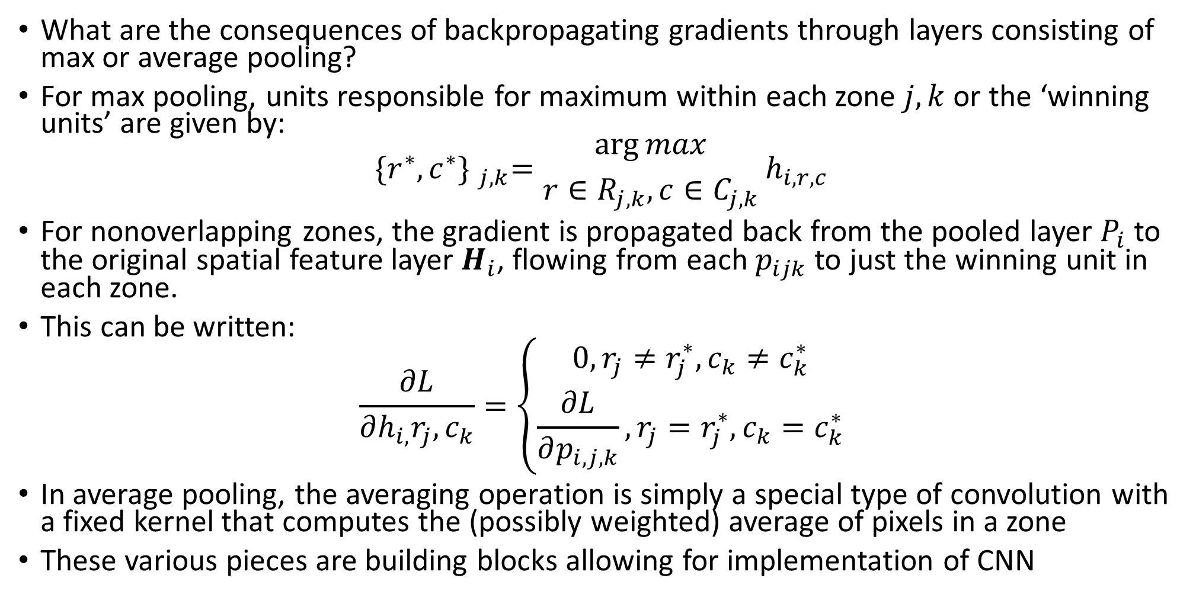
Pooling and subsampling layers and gradients
What are the consequences of backpropagating gradients through layers consisting of max or average pooling?
For max pooling, units responsible for maximum within each zone $j,k$ or the ‘winning units’ are given by:
$${\{r^{∗},c^{∗}\} }_{j,k}={\arg{max} \atop r∈R_{j,k}, c∈C_{j,k}}h_{i,r,c}$$
For nonoverlapping zones, the gradient is propagated back from the pooled layer $P_{i}$ to the original spatial feature layer $H_{i}$, flowing from each $p_{ijk}$ to just the winning unit in each zone.
This can be written:
$$\frac{∂L}{∂h_{i,}r_{j},c_{k}}=\left\{\begin{aligned}0, r_{j}≠r_{j}^{∗},c_{k}≠c_{k}^{∗} \\ \frac{∂L}{∂p_{i,j,k}}, r_{j}=r_{j}^{∗}, c_{k}=c_{k}^{∗}\end{aligned}\right.$$
In average pooling, the averaging operation is simply a special type of convolution with a fixed kernel that computes the (possibly weighted) average of pixels in a zone
These various pieces are building blocks allowing for implementation of CNN

Slide 14
CNN demonstration
Keras (spyder)
copy-paste code into Google colabs

